Slide 1
Security and Privacy: When Worlds Collide
Alan Levine, CISO, CPO Alcoa Inc.
November 11, 2013
Notes:
In the wake of highly publicized cyber attacks on large, well-respected companies and public institutions I am certain that you have asked yourself the question “Can Alcoa be the victim of a cyber attack?” “Yes” is the only honest answer at a time when ever more value is migrating online, when business strategies require more open and interconnected technology environments, when attackers have always-expanding capabilities, and when attacks take advantage of limited security awareness among employees and customers.
I’m going to spend the next 20 minutes talking about cyber events in Alcoa, the continuing evolution of our security program, and how we continue to grow our defenses in this area.

Slide 2
My roles intertwine
Cyber Security
Mission
Data Privacy
Mandate
Controlled Data
Mandate
eDiscovery
Mandate

Slide 3
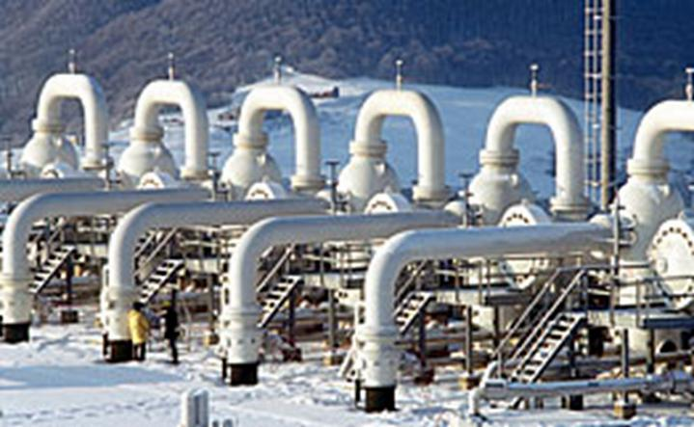

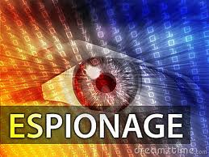
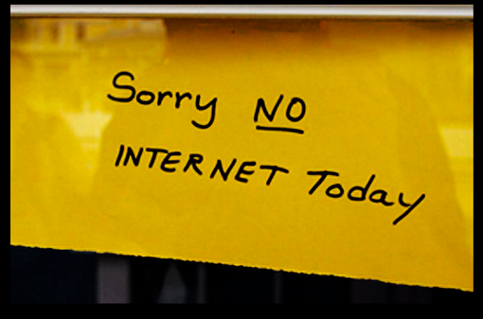
The Security/Privacy Link is Obvious
Security Event
Privacy Implication
Hackers Mount Cyber Attack on U.S. Gas Pipelines
(May 2012)
Cyber attack targets U.S. gas pipelines to steal passwords and gain access to critical systems. Source and intent unknown.
6.4 Million Passwords Stolen
From LinkedIn Website
(June 2012)
LinkedIn investigated claims that more than 6 million passwords were stolen. LinkedIn confirmed the security breach. Similar breaches everywhere.
New Cyber-Espionage Spyware Resembles Stuxnet
(May 2012)
Spyware (Flame) can record audio, screen images, keyboard activity, network traffic, and can export files to remote servers.
No Web for Hundreds of Thousands on Monday (July 2012)
Internet connections impacted July 9th when the FBI remediated servers associated with a Botnet cyber fraud scam.
Source: ABC News; Nextgov; MIT Technology Review
Notes:
Recently the FBI told us that cyber threats will supercede counter-terrorism as the #1 threat. We live in a world where it is a must to build cyber into contingency planning
Atos, the technology company responsible for the networks supporting the Olympic Games in London this summer, says it has employed a group of "ethical hackers" to help test and defend the Games from potential cyber attacks
U.S. military sharpens preparation for cyberwar. The U.S. military is ramping up efforts to combat cyberwarfare. In June the U.S. Air Force graduated its first class of airman trained “to hunt down electronic intruders, defend networks and launch cyberattacks.” Other branches of the military are also building cyberwarfare capabilities.
Remember Stunet Stuxnet the computer worm discovered in June 2010. Stuxnet initially spreads via Microsoft Windows, and targets Siemens industrial software and equipment?
FLAME – Flame is new spyware with Stuxnet like capabilities and more. It can record audio, screen images, keyboard activity, network traffic and exfiltrate files to remote servers. The complex malware reportedly is part of a joint U.S.-Israeli campaign aimed at sabotaging the Iranian nuclear program. It is anticipated that the code utilized will start appearing in other attacks globally.
THOUSANDS FACE INTERNET BLACKOUT AS FBI CUTS SEIZED SERVERS
You may also have recently read that on July 10th, roughly 300,000 internet users across the globe were expected to lose access to the internet today as the FBI shuts down servers it seized in November 2011 in order to nab a gang of cyber criminals. The group of fraudsters infected over a half million computers with malware that targeted domain name routing, forcing users to view certain advertisements. The scam resulted in the gang being paid over $14 million. The "clickjacking scheme," started in 2007, involved six Estonians and one Russian that used several front companies to perpetrate their scam. Since the FBI took over the affected servers late last year, it has worked with internet service providers to alert those with infected PCs. While most users have sought technical solutions, just over 300,000 users, many of which reside in the United States, have not
Other possible examples from Alan on July 11, 2012:
Massive Google Cyber Attacks
A "highly sophisticated and targeted" attack against Google originated in China and tried to access Gmail accounts.
http://www.telegraph.co.uk/technology/google/8553131/Google-Gmail-cyber-attack-Chinese-spies-had-months-of-access.html
LinkedIn Hacked
60% of all user passwords on popular social site exposed.
http://www.theverge.com/2012/6/7/3071707/linkedin-hack-six-million-passwords-leaked

Slide 4
Not to Mention…
The NSA

Slide 5
Information security is how we ensure data privacy
Security we use
Outcomes we expect
Passwords
Access Controls
ERM
DLP
SIEM
Reporting Controls
PII
PHI
European law
Other Country law
Safe Harbor

Slide 6
Sometimes, the ends don’t meet
Russia Telecommunications Law
German Privacy Law
Blackberry/BES conflicts
You can move the email server
But you can’t move the BES
And the government needs access
You should not permit personal use
Personal use could mean no permitted logging
Personal use could mean no investigation sources

Slide 7
The APT Conundrum: Collision Straight Ahead
Email arrives with link
User clicks on link
Website downloads malicious software
What do we need to do?
Who received the email?
Who clicked on the link?
Who accessed a file or folder?
What can a client forensic tell us? And what does it learn about you?

Slide 8
Big data? How about no data?
Acceptable Use investigations
Can you think of all the other reasons we need to keep a history?
Cloud decisions - where can we go?
Mobile choices – MDM and other confusions
Crowd Sourcing
The predicate for many Privacy positions is, simply,
YOU CAN’T DO THAT!

Slide 9
Questions?

